Slide 1
Evaluating UI Designs (Part 4)
CSE463
Dr. Atkinson
3.27.17

Slide 2
Execution phase: ethics of human experimentation
Users feel exposed using unfamiliar tools and making errors
Guidelines:
Re-assure that individual results not revealed
Re-assure that user can stop any time
Provide comfortable environment
Don’t laugh or refer to users as subjects or guinea pigs
Don’t volunteer help, but don’t allow user to struggle too long

Slide 3
Execution phase: ethics of human experimentation
In de-briefing
answer all questions
reveal any deception
thanks for helping

Slide 4
Data Collection - Usability Labs and Equipment

Slide 8
Analysis of data
Before you start to do any statistics:
look at data
save original data
Choice of statistical technique depends on
type of data
information required
Type of data
discrete - finite number of values
continuous - any value

Slide 9
What can statistics tell us?
The mean time to perform a task (or mean no. of errors or other event type).
Measures of variance – standard deviation
(For a normal distribution:
1 standard deviation covers ~ 2/3 of the cases)

Slide 10
What can statistics tell us?
Confidence intervals (the smaller the better)
the “true mean” is within N of the observed
mean, with confidence level (probability) .95
Since confidence interval gets smaller as #Users grows:
how many test users required to get a given
confidence interval and confidence level

Slide 11
Testing usability in the field
Direct observation in actual use
discover new uses
take notes, don’t help, chat later
Logging actual use
objective, not intrusive
great for identifying errors
which features are/are not used
privacy concerns

Slide 12
Testing Usability in the Field (cont.)
Questionnaires and interviews with real users
ask users to recall critical incidents
questionnaires must be short and easy to return
Focus groups
6-9 users
skilled moderator with pre-planned script
computer conferencing?

Slide 13
Testing Usability in the Field (cont.)
On-line direct feedback mechanisms
initiated by users
may signal change in user needs
trust but verify
Bulletin boards and user groups

Slide 14
Field Studies: Pros and Cons
Advantages:
natural environment
context retained (though observation may alter it)
longitudinal studies possible
Disadvantages:
distractions
noise

Slide 15
Field Studies: Pros and Cons
Appropriate
for “beta testing”
where context is crucial for longitudinal studies

Slide 16
Elements for Good Experimental Research
Causality
Variables
Hypothesis
Random assignment

Slide 17
Advantages of Experimental Research
internal validity, or the extent to which the experimental approach allows the researcher to minimize biases or systematic error and demonstrate a strong causal connection
precise control of the levels of the independent variable along with random assignment to isolate the effect of the independent variable upon a dependent variable
build up models of interactions among variables to better understand the differential influence of a variable across a range of others
systematic process to test theoretical propositions an
be replicated and extended d advance theory

Slide 18
Limitations of Experimental Research
difficult to achieve if the outcomes depend on a large number of influential factors or if carefully controlling those factors is impractical
risk of low external validity
replication is often less valued (and thus harder to publish) in HCI than the novelty of invention
sometimes force-fit into situations where research questions might have been more appropriately addressed using less formal instantiations of the experimental method or by using other methodologies

Slide 19
How to Do It

Slide 20
Hypothesis Formulation
A hypothesis both defines the variables involved and the relationship between them, and can take many forms: A causes B; A is larger, faster, or more enjoyable than B; etc.

Slide 21
Characteristics for good hypothesis
Precise
Meaningful
described relationship needs to be testable
predicted relationship must be falsifiable

Slide 22
Evaluating Your Hypothesis

Slide 23
Hypothesis Testing
The first step in null hypothesis significance testing is to formulate the original research hypothesis as a null hypothesis and an alternative hypothesis.
The second step is to decide on a significance level.
The third step is to collect the data (this is a big step that is addressed later in the chapter) and then apply the appropriate statistical test to obtain a p value.
The final step compares the observed p value with the previously stated significance level.

Slide 24
Estimation Techniques
To address some of the challenges of traditional hypothesis testing approaches, contemporary methods rely on estimation techniques that focus on establishing the magnitude of an effect through the application of confidence intervals and effect sizes.

Slide 25
Variables

Slide 26
Independent Variable
The independent variable (IV) is manipulated by the researcher, and its conditions are the key factor being examined
establish well-controlled variation in its conditions or levels
provide a clear operational definition and confirm that your IV has the intended effect on a participant.
factor to consider is the range of the IV (i.e., the difference between the highest and lowest values of the variable).

Slide 27
Dependent Variable
The dependent variable (DV) is the outcome measure whose value is predicted to vary based upon the levels of the IV.
Reliability
Validity
Range
Practicality

Slide 28
Control Variable
A control variable is a potential IV that is held constant. For example, when running reaction time studies, you need to control lighting, temperature, and noise levels and ensure that they are constant across participants.

Slide 29
Covariate
Covariates (or, somewhat confusingly, “control variables” in the regression sense) are additional variables that may influence the value of the dependent variable but that are not controlled by the researcher and therefore are allowed to naturally vary.

Slide 30
Research Designs

Slide 31
Randomized Experiments
between-subjects design: is one of the most commonly used experimental designs and is considered by many to be the “gold standard” of randomized experimental research. Participants are randomly assigned to a single condition (also known as a level of the IV).
within-subjects design: is one in which participants are assigned to all conditions (i.e., all levels of the IV) or have repeated exposure to a single condition (known as a repeated measure design).

Slide 32
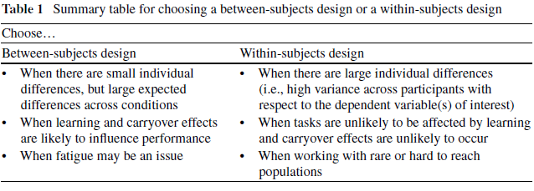

Slide 33
Factorial Designs
In many studies you will want to observe multiple independent variables at the same time, such as gender, display size and task complexity.
In such a design each variable is called a factor, and the designs that make use of many factors are factorial designs.
Factorial designs can be either between subjects, within-subjects, or both in what is known as mixed factorial designs.

Slide 34
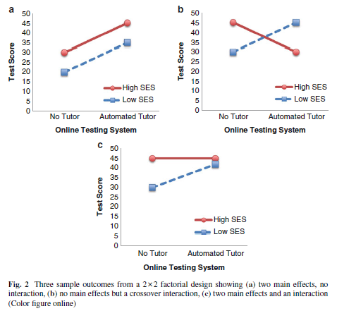

Slide 35
Quasi-Experimental Designs
Quasi-experimental designs aim to address the internal validity threats that come about from a lack of randomization. The designs tend to vary along two primary dimensions: those with or without control or comparison groups; and those with or without pre- and post-intervention measures.

